Slide 1
TLS & HTTPS

Slide 2
TLS

Slide 3
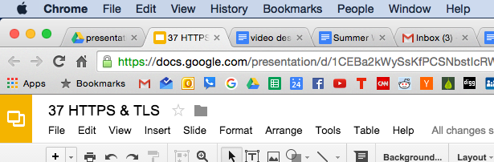

Slide 4
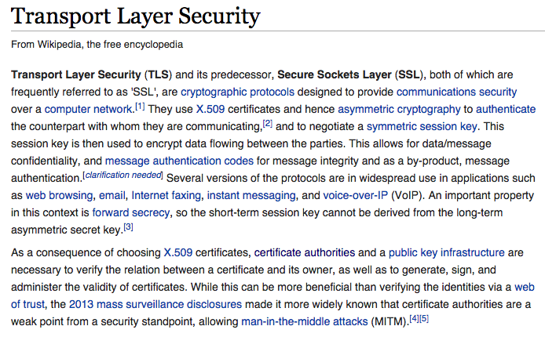

Slide 5
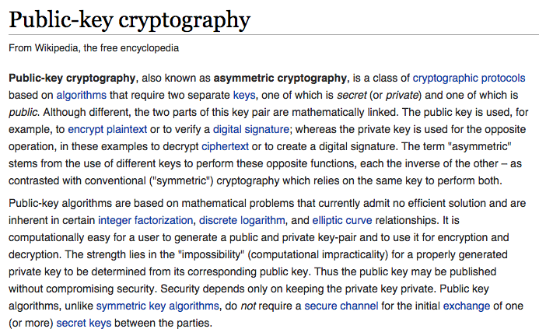

Slide 6
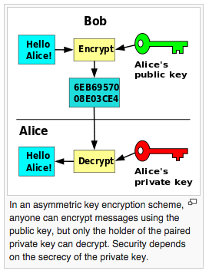

Slide 7
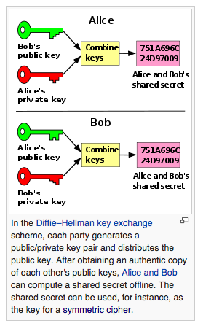

Slide 8
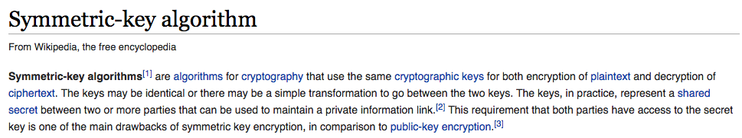

Slide 9
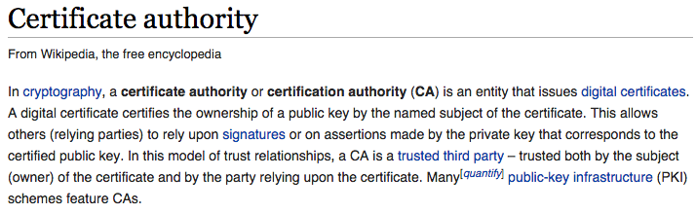

Slide 10
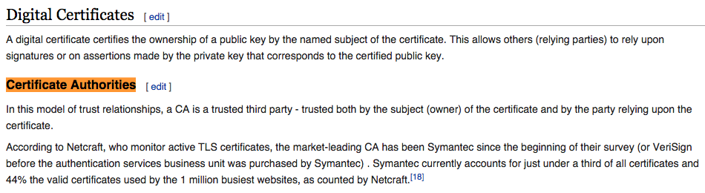

Slide 11
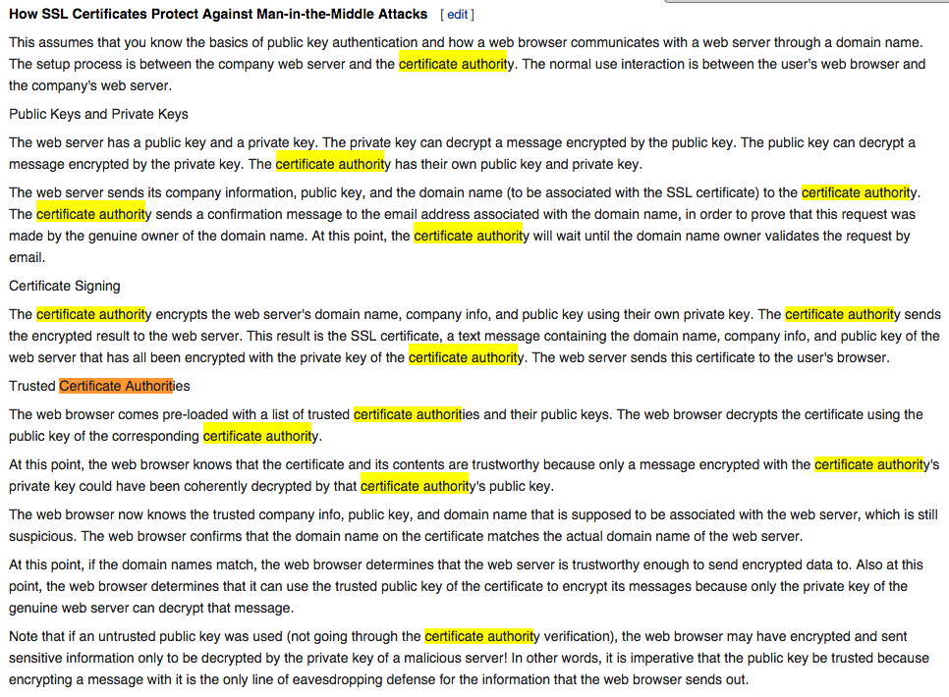

Slide 12
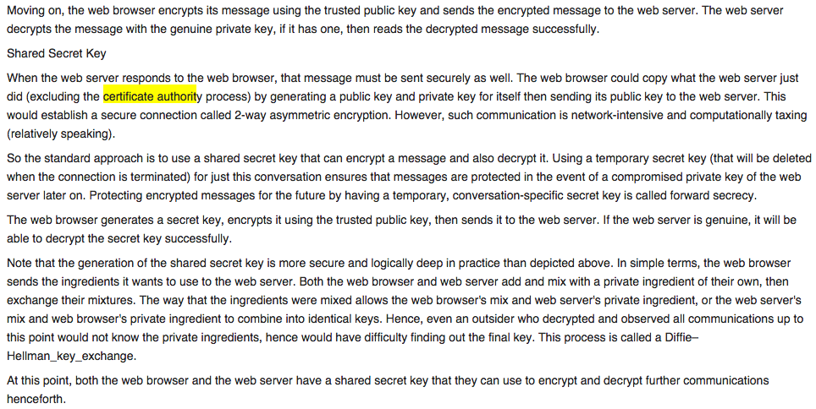

Slide 13
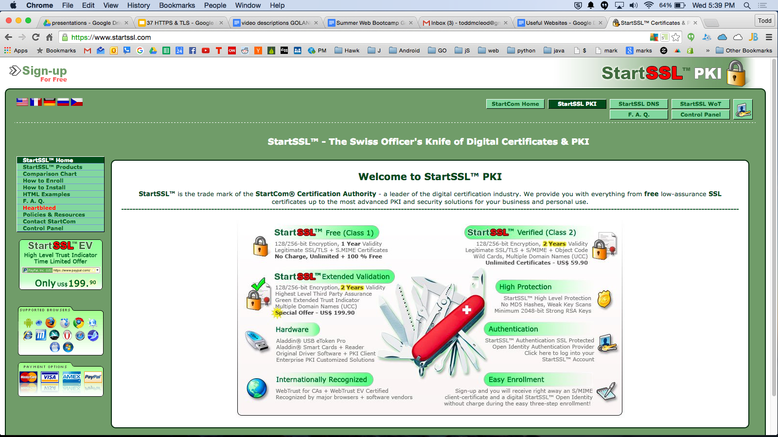

Slide 14
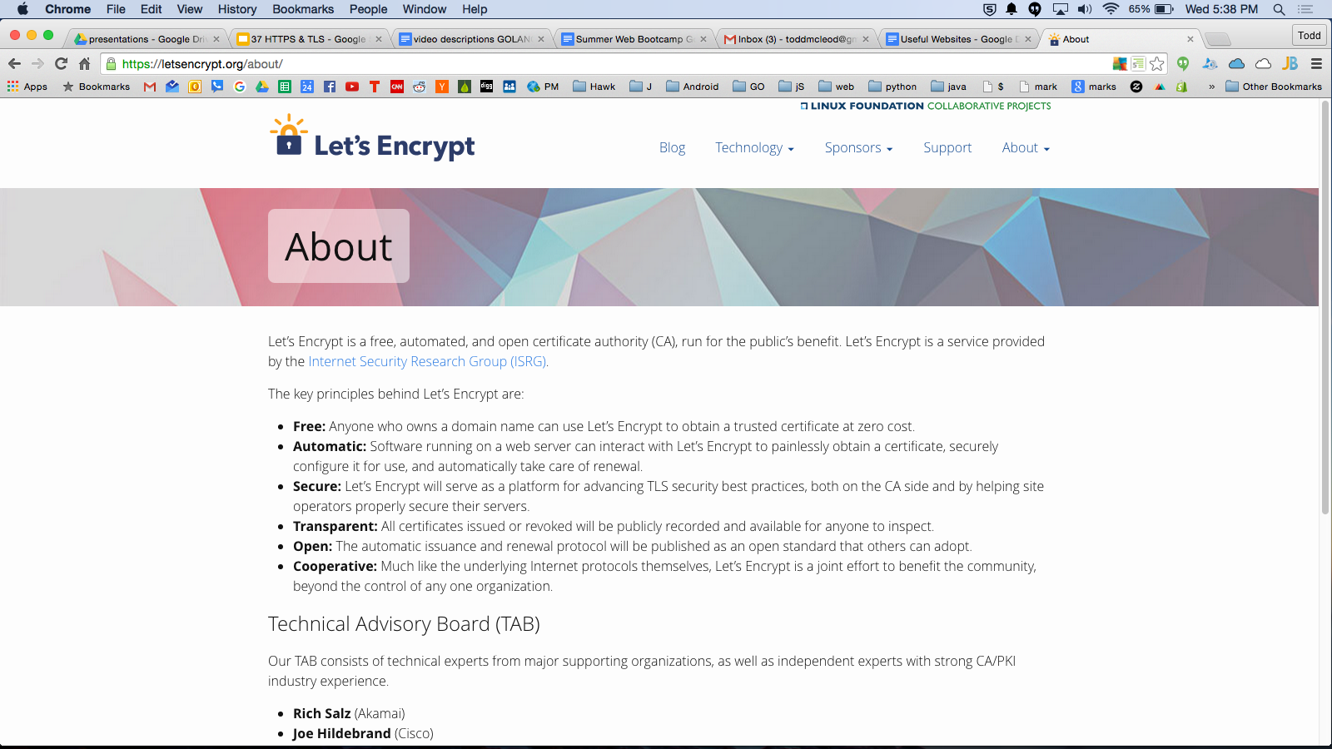

Slide 15
getting a certificate

Slide 16
self-signed certificate
go run $(go env GOROOT)/src/crypto/tls/generate_cert.go --host=somedomainname.com
eg
go run $(go env GOROOT)/src/crypto/tls/generate_cert.go --host=localhost

Slide 18
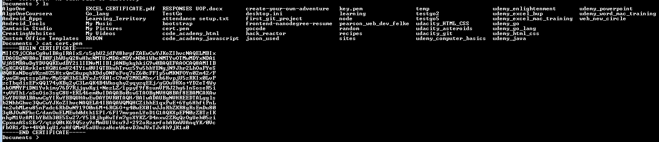
don’t share this one; the key to the kingdom
cert.pem
is the public key
base 64 data

Slide 19
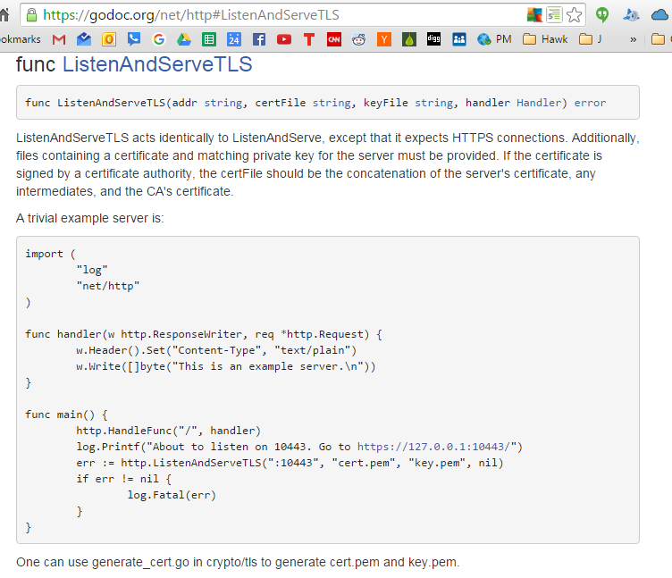

Slide 20
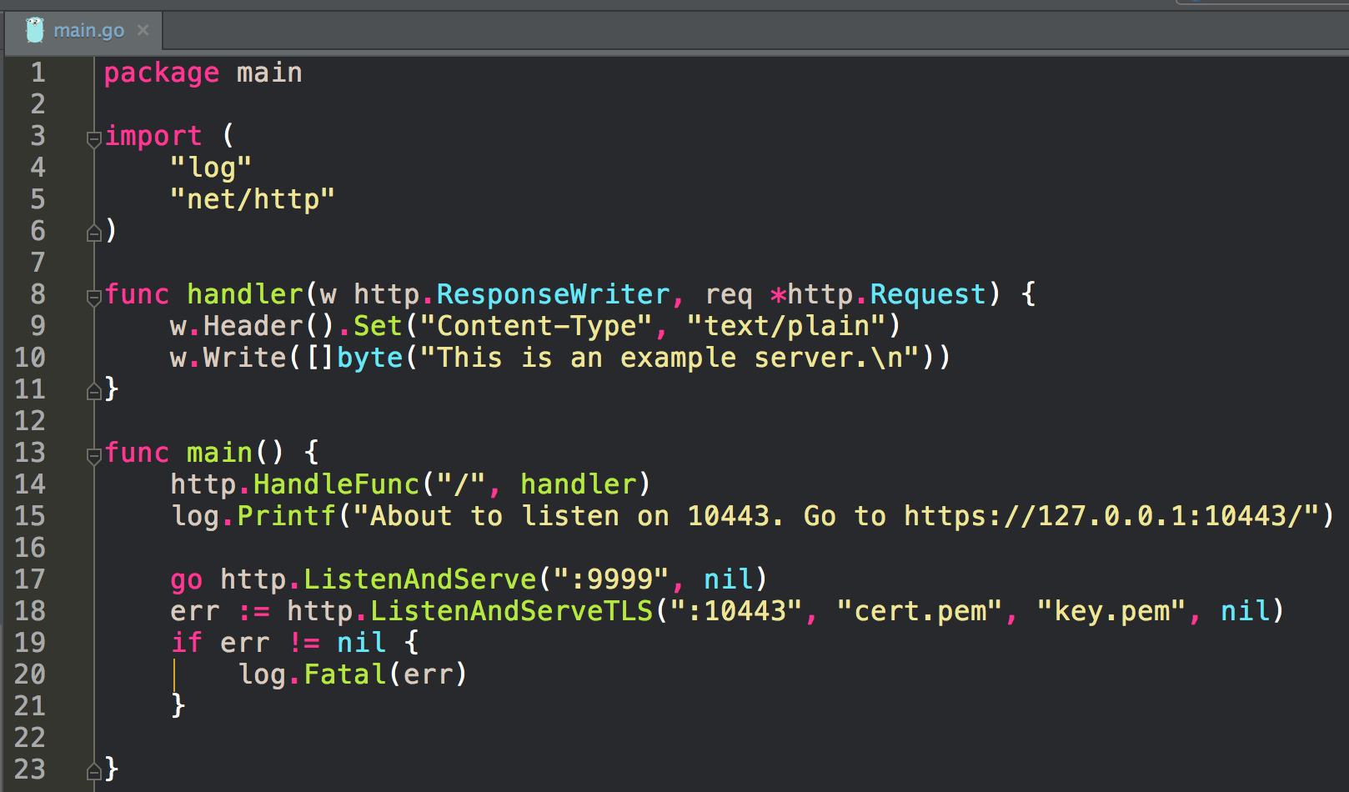

Slide 21
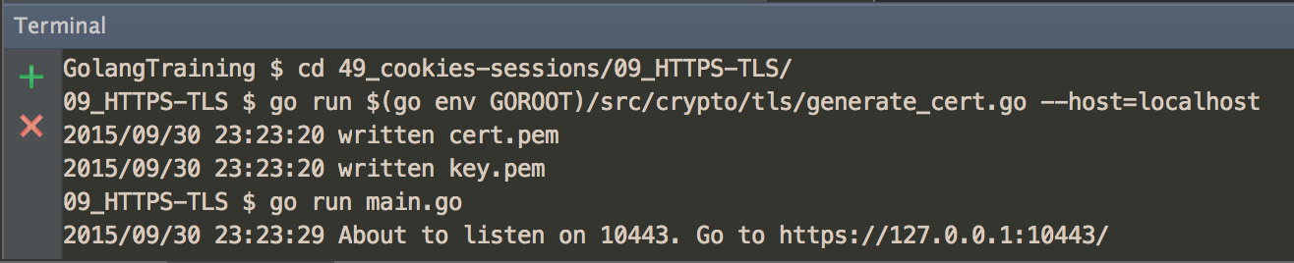

Slide 22
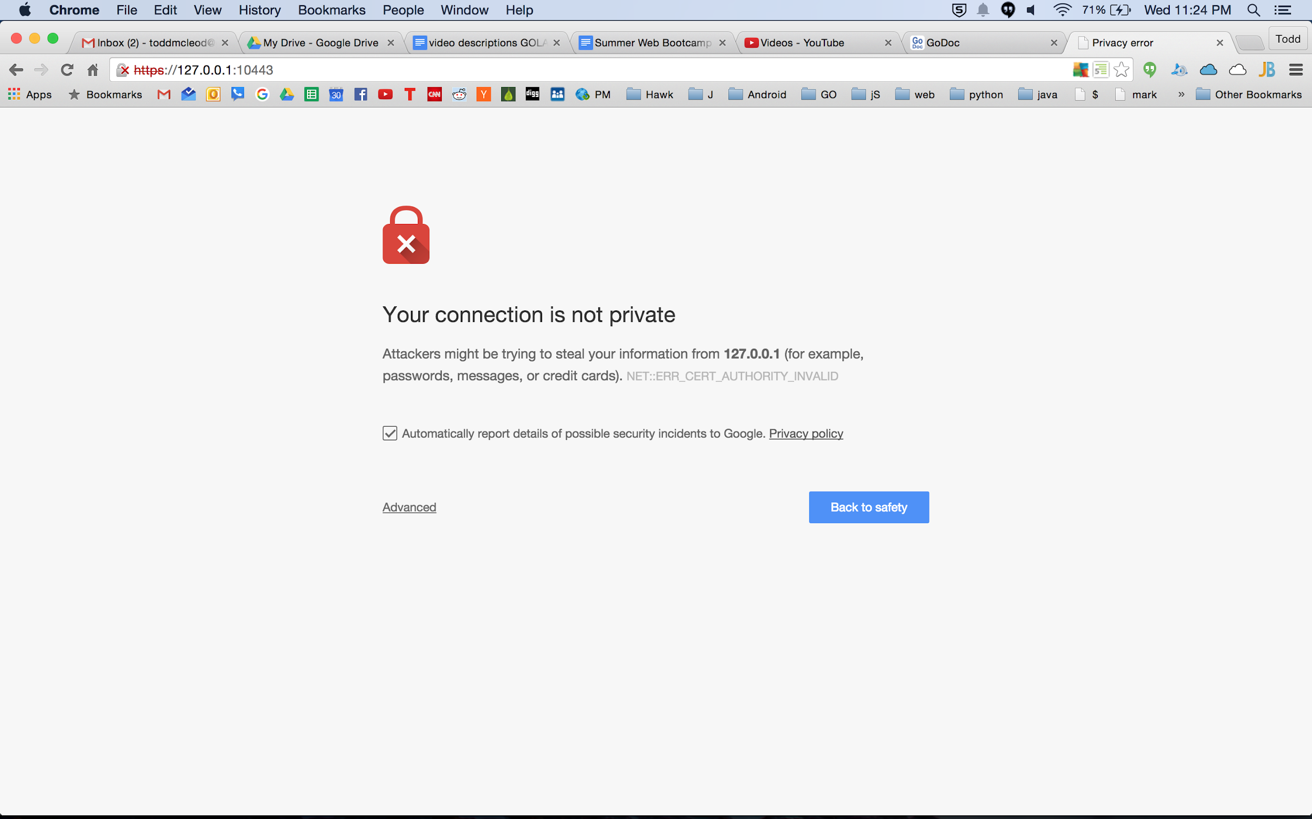

Slide 23
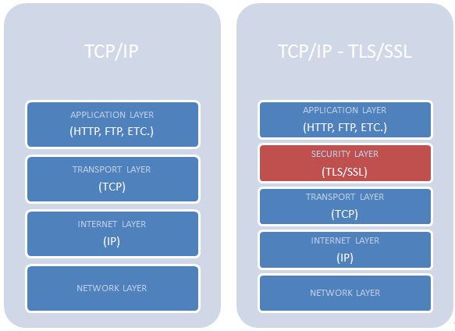

Slide 24
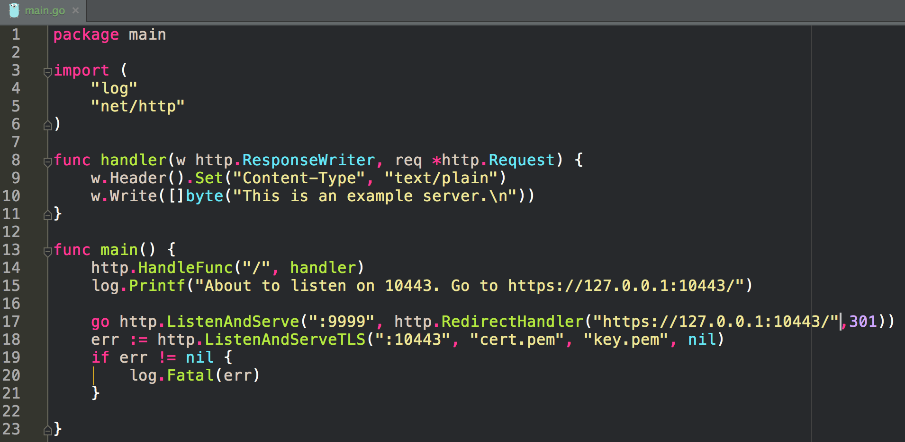

Slide 25
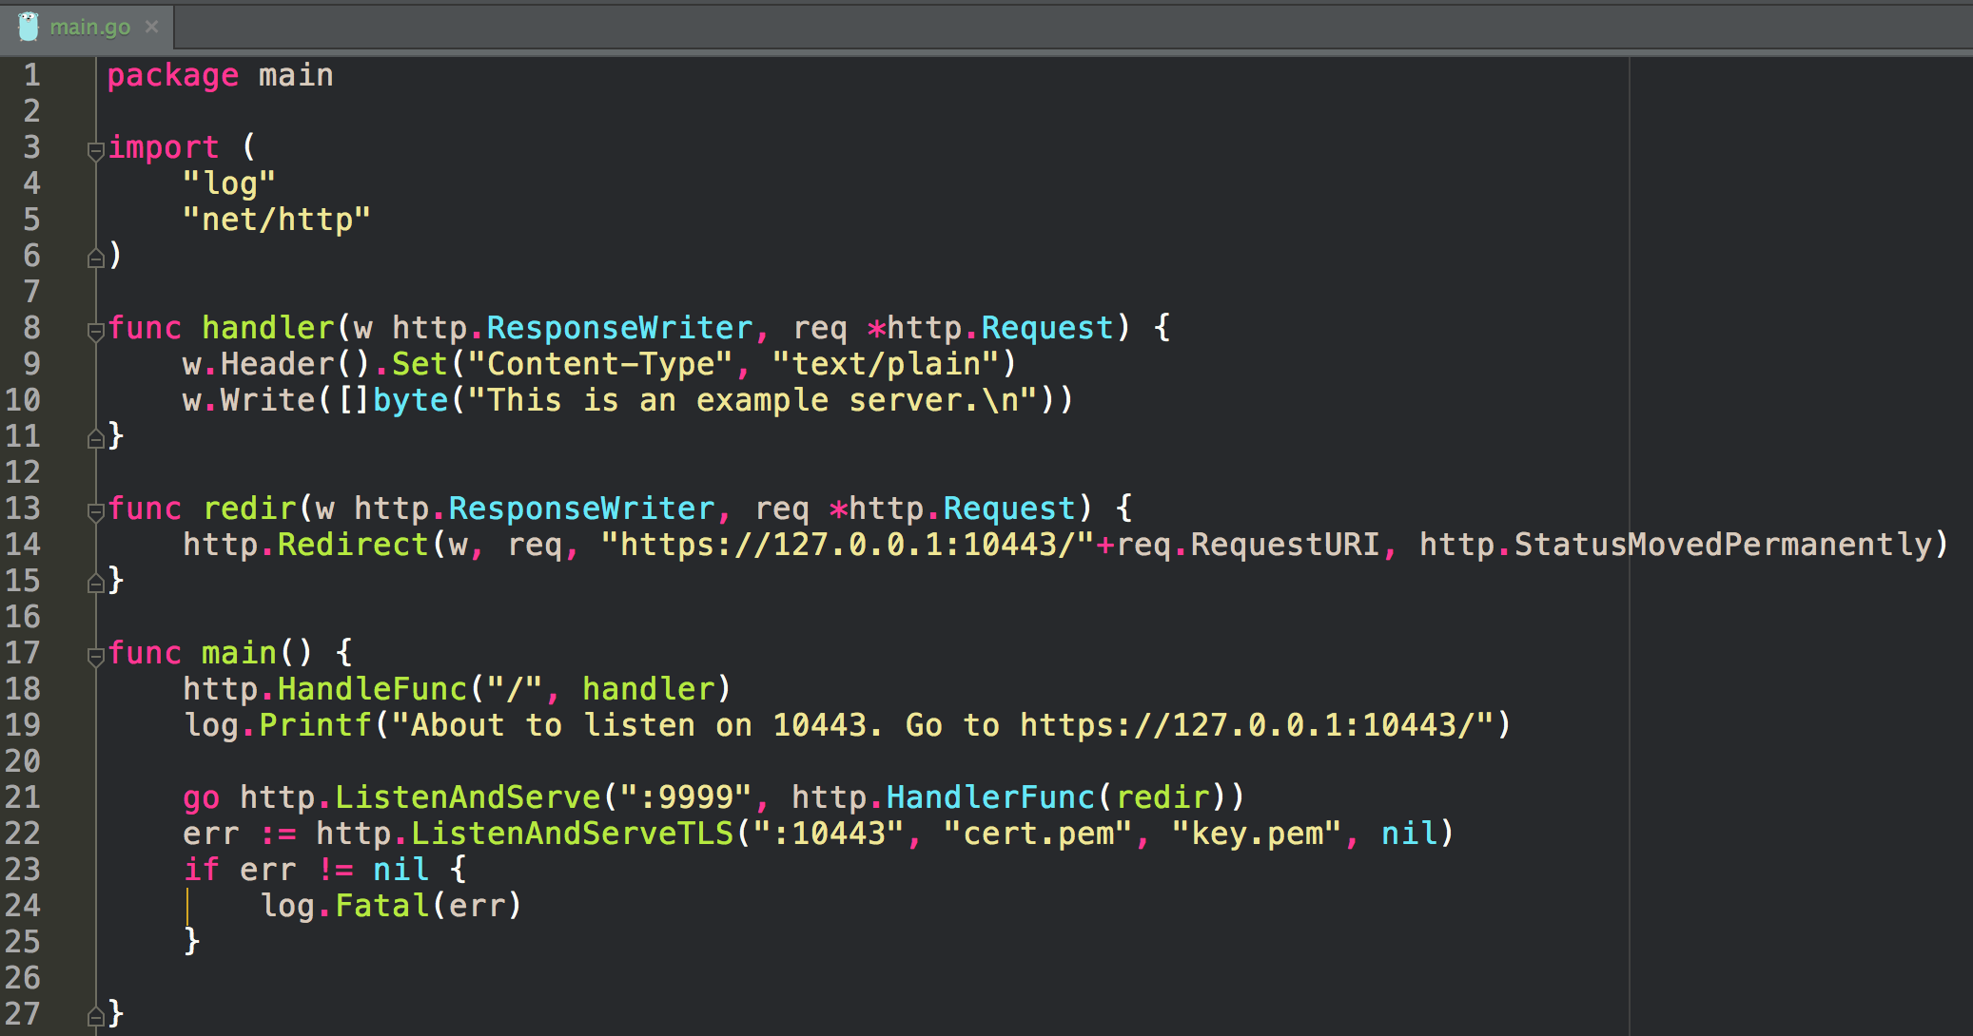

Slide 26
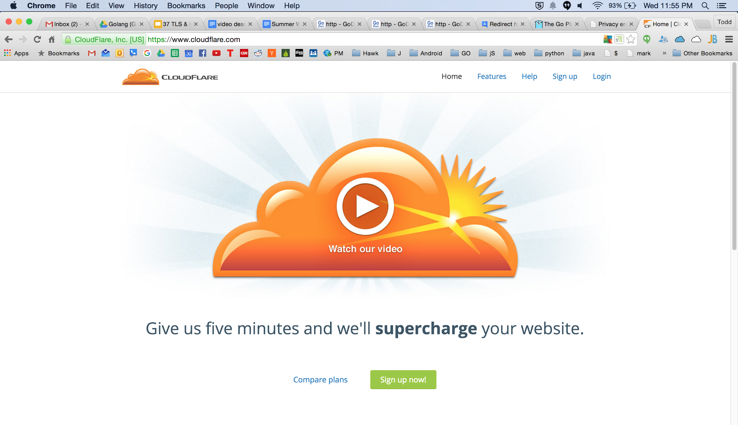

Slide 27



your site
self signed cert
cloudflare
your site
self signed cert

Slide 28
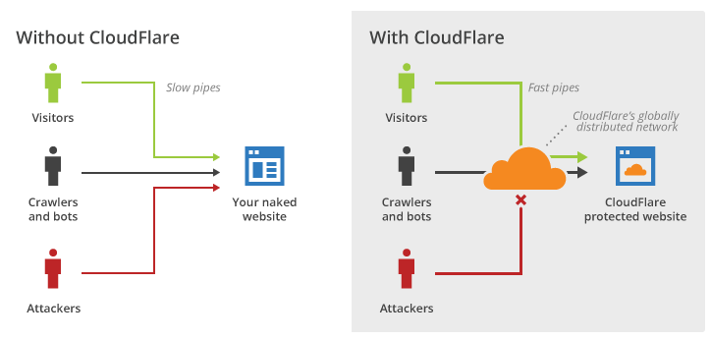

Slide 29
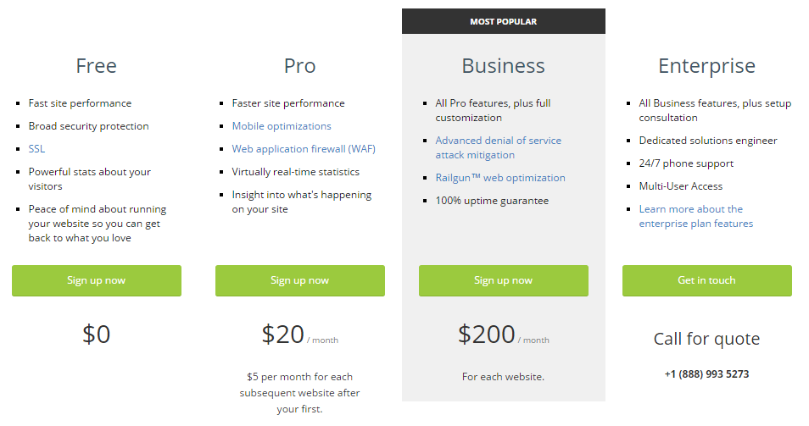

Slide 30
exercise

Slide 31
TLS
Create a certificate and use it with ListenAndServeTLS in an http server.

Slide 32
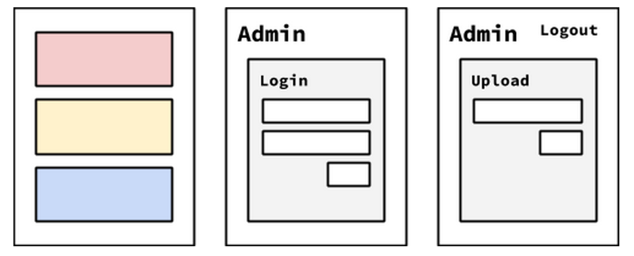
Photo Blog
Our goal for this project is to create a basic photo blog. It should have a few pages:
The initial page (https://localhost:8080/) should list the most recent uploaded photos.
Clicking a photo should download it. (hint: HTML5 download attribute or the Content-Disposition header)
There should be an admin page (https://localhost:8080/admin) which allows a user to login (you can hardcode the username and password).
Once logged in the admin user should be presented with a form to upload an image.
The uploaded image should then be accessible on the main page.
The admin section should require TLS.
A self-signed certificate is ok. It’s ok to require TLS for the regular section of the site as well.

